Slide 1
Publishing websites

Slide 2
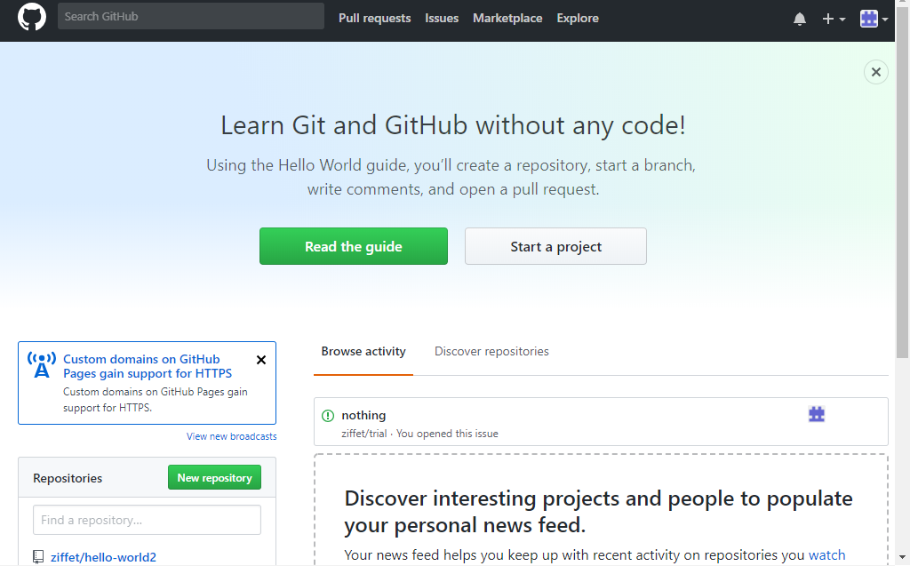
Sign up for github online

Slide 3
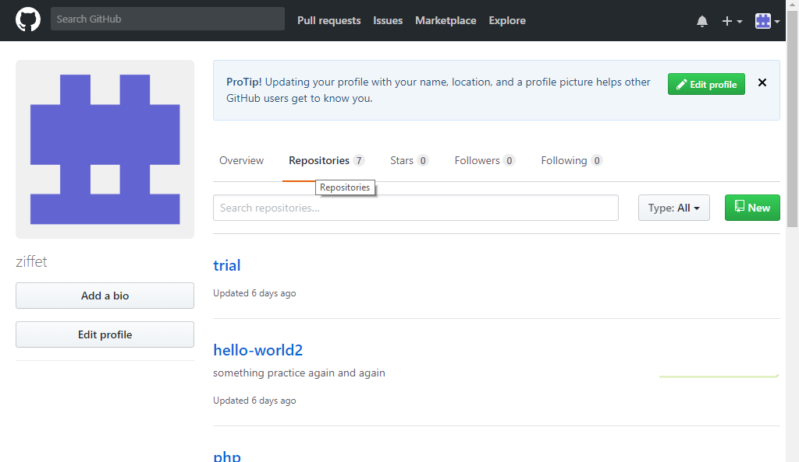
Create a new repositary

Slide 4
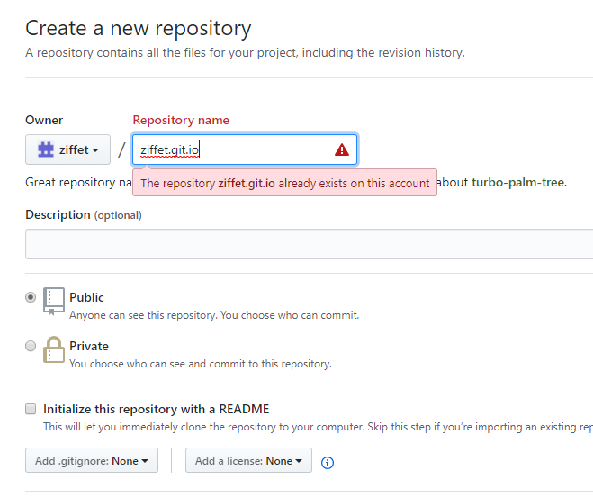
Name the repository as your username.git.io

Slide 5
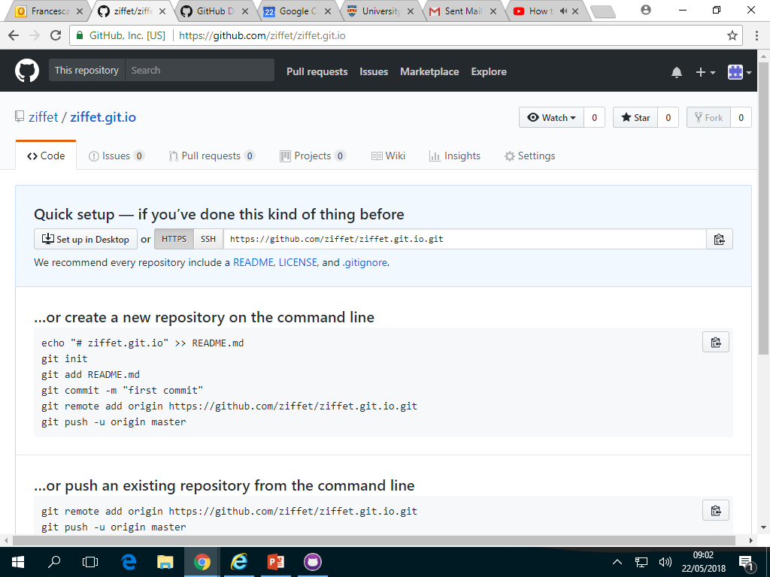
This screen should appear

Slide 6
Download github desktop

Slide 7
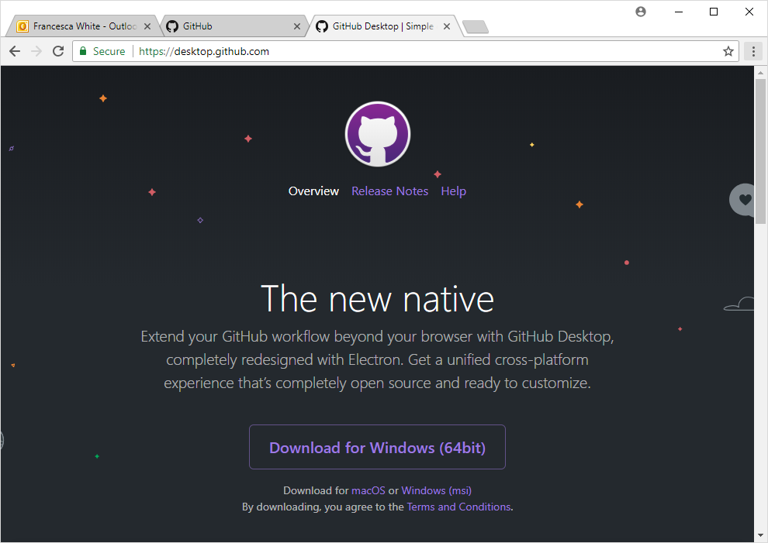
Download github

Slide 8
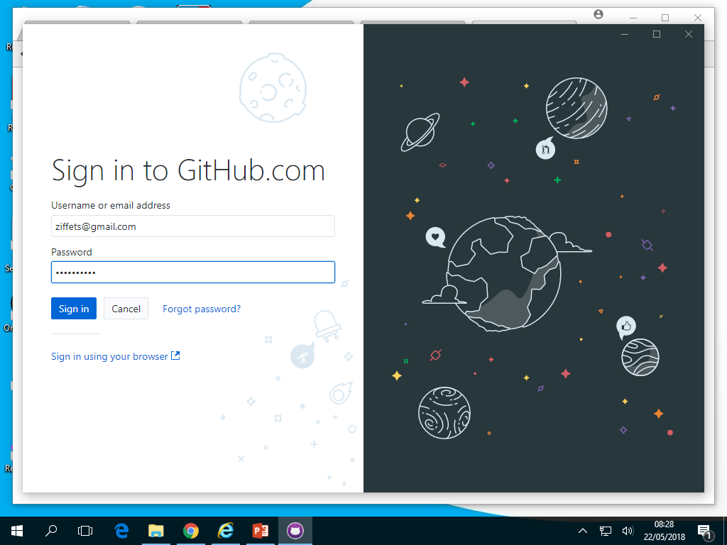

Slide 9
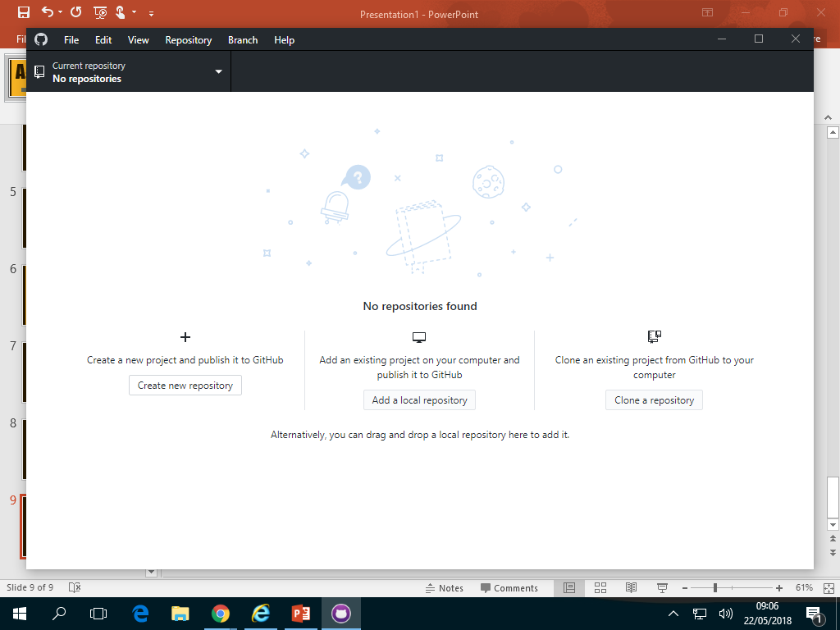
Clone your repository

Slide 10
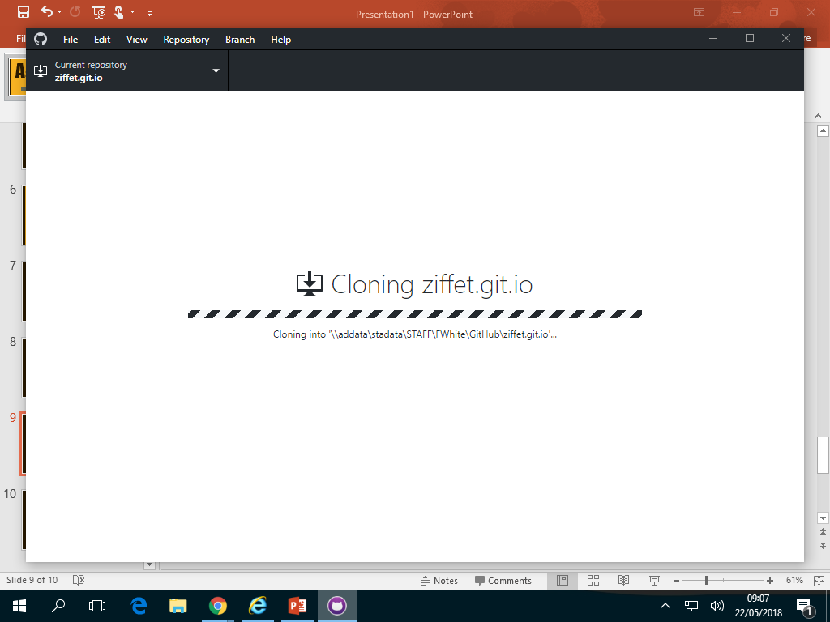

Slide 11
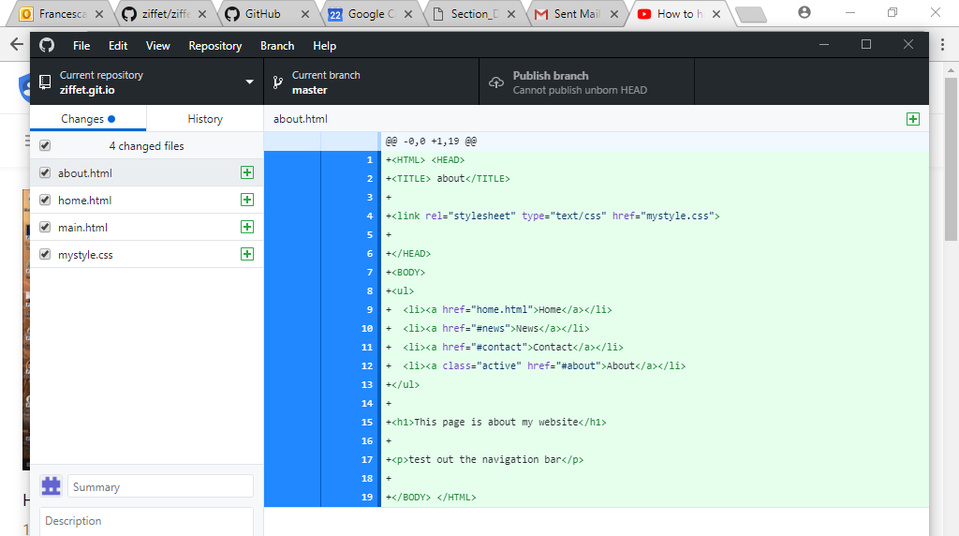

Slide 12
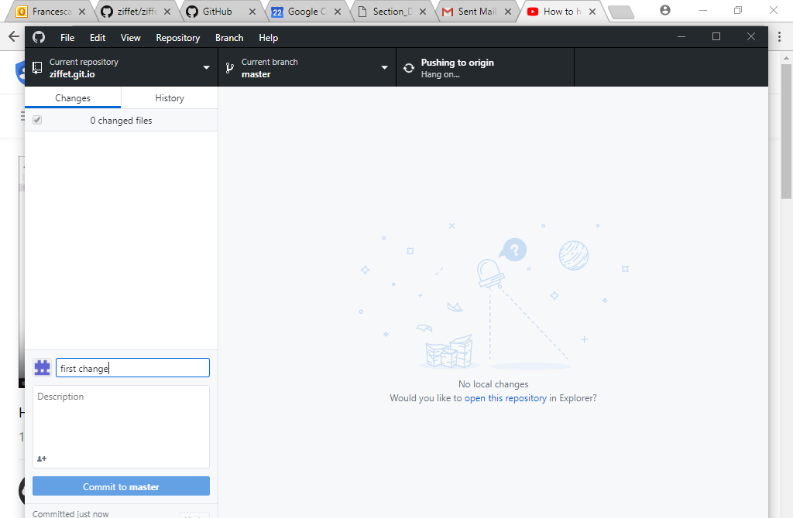
Add a new change, press commit to master and then publish

Slide 13
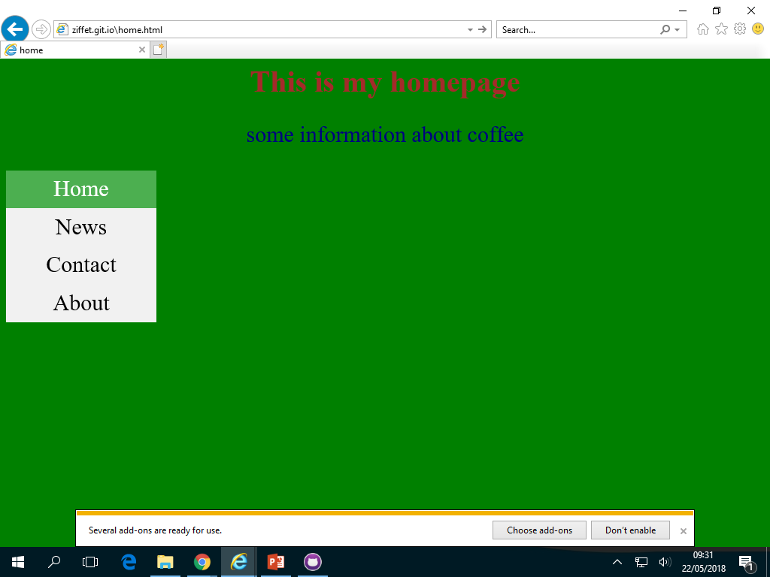
Check out your website by going to repository name .git.io

